Slide 1

JavaScript Advanced
Course Overview
SoftUni Team
Technical Trainers
Software University
https://softuni.bg

Slide 2
Table of Contents
Introduction
Training & Team
Course Objectives
Course Organization

Slide 3
Have a Question?
sli.do
#js-advanced

Slide 4














SoftUni Diamond Partners

Slide 5

JS Advanced
Course Objectives & Program

Slide 6

JS Advanced – Course Topics
Syntax, Functions and Statements
Arrays
Objects & Classes
DOM
DOM Manipulations

Slide 7

JS Advanced – Course Topics
6. Function Context
7. Advanced Functions
Object Composition
Prototypes and Inheritance
10. Workshop

Slide 8

Trainers and Team

Slide 9
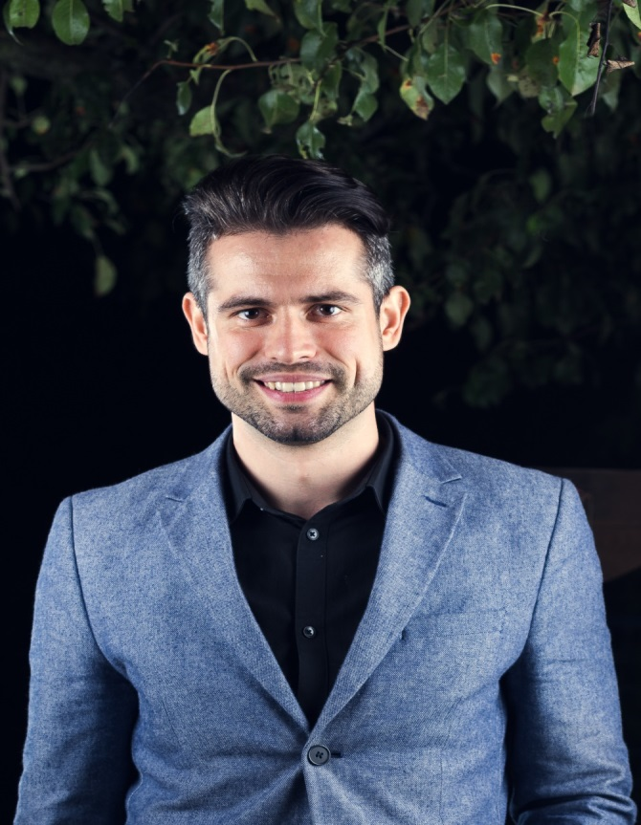
Ivaylo Papazov
Senior Full-Stack Developer @ Motion Software
Technical Trainer @ SoftUni
Experience in JS, C#, Node.js, React, ASP.NET MVC
TelerikAcademy Graduate

Slide 10
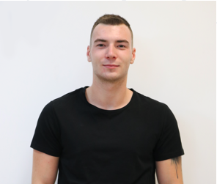
Konstantin Mitev
Mid Java Developer
Technical Trainer @ SoftUni
Graduated in Java and JavaScript professions
Experience in React JS

Slide 11

Course Details and Schedule
Course Objectives

Slide 12
Targets of the Course
Advanced coding skills for the JS language
Extends the JS Fundamentals course
Covers: Arrays, Objects, Advanced Functions, DOM, Classes, Object Composition, Prototype Chain

Slide 13

Practical Exam
Structure: 3 problems for 4 hours
Exam: 24 Oct 2020
Retake: 9 Dec 2020
Problems description:
DOM Manipulations
Classes
Inheritance

Slide 14
Theoretical Exam
about 20 questions for 30 minutes
Multiple-choice
English
Automated quiz system
Available online
You can submit your answers just one time

Slide 15
JS Advanced Course - Timeline
14-Sept-2020
24-Oct-2020
09-Dec-2020
JS Advanced
6 weeks * 4 times / week
12 credits
Start: 14-Sept-2020
Theoretical Exam: 24-Oct-2020
Practical Exam: 24-Oct-2020
Re-Take Exams
Retake Practical: 09-Dec-2020
Retake Theoretical: 09-Dec-2020

Slide 16


SoftUni Certificate
Practical Exam 100%
Homework 5%
Evaluation
16

Slide 17
CPE Certificate
Theoretical Exam 100%
Evaluation
17

Slide 18




Course Web Site, Forum and FB Group
Official web site:
Official discussion forum:
Official Facebook group:
Official SoftUni JavaScript Community:
softuni.bg/trainings/3011/js-advanced-september-2020
softuni.bg/forum/categories/107/
facebook.com/groups/JSAdvancedSeptember2020/
facebook.com/groups/SoftUniJavaScriptCommunity/

Slide 19
Questions?
Notes:
19

Slide 20
Trainings @ Software University (SoftUni)
Software University – High-Quality Education, Profession and Job for Software Developers
softuni.bg, softuni.org
Software University Foundation
softuni.foundation
Software University @ Facebook
facebook.com/SoftwareUniversity
Software University Forums
forum.softuni.bg
Notes:
20

Slide 21

License
This course (slides, examples, demos, exercises, homework, documents, videos and other assets) is copyrighted content
Unauthorized copy, reproduction or use is illegal
© SoftUni – https://about.softuni.bg/
© Software University – https://softuni.bg
Notes:
21

